Slide 1
Human movement by analysing data collected with a 3D motion capture system
Created by Billy Robinson
Notes:
Brief introduction to the research question/problem to be solved

Slide 2
Brief introduction to the problem
The client wants us to measure their clients “Deep squat angle” so that they can use this data to assist them in correcting people’s posture.
The client wants to innovate their current method, which uses a goniometer to measure the person’s deep squat angle, which is manually measured.
The client wants to improve reliability and repeatability of the measurements so that it doesn’t effect the final outcome for the patient.
The solution must be able to be done quickly
The client believes that this is an important change as they believe it will help out patients.
So: Can we use computer based motion analysis (using the Microsoft Kinect) to replace the client’s current outdated method and make it more reliable and repeatable?

Slide 3
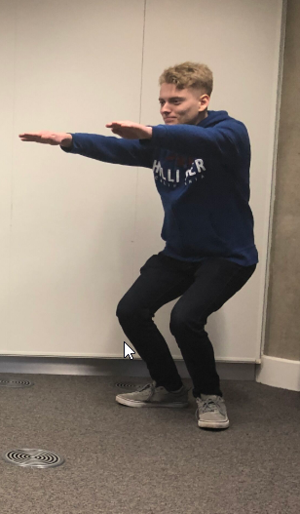
How we collected the data
In order to collect the data, we used a Microsoft Kinect, this is a device that was created in 2010 originally created for the Xbox games console in order to make it interactive. It works by tracking points on someone’s body and plotting an xyz coordinate, allowing it to record data which can be utilized by a computer program.
Within this specific scenario: we had someone squat in front of a Kinect device and we recorded their XYZ coordinates frame by frame automatically, tracking various points on the person’s body – reducing measurement time and human error.
We then exported these measurements to an external data manipulation tool, which allowed us to analyse the data via graphs and utilize this data in our calculations to get the person’s deep squat angle.
Notes:
Explanation of the method used to gather the data (tasks carried out by the participant and measurements taken)

Slide 4
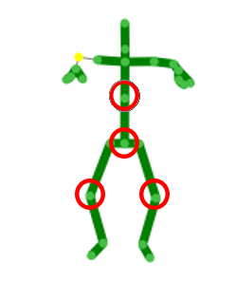
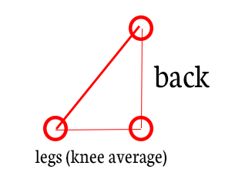
Explanation of the data visualization techniques used
In order to create the graphs, I took into account the X, Y and Z coordinates of the dataset, plotted them on a graph and then added the coordinates together to create a total for each of the 4 points (Legs, Hips and Back) I will be using to calculate a final angle for each squat.
Using these coordinates, we can then calculate the angle of the squat by using the vertices, with the back being placed at the top of the triangle and the hips being placed at the bottom (making a straight ish line, representing the back). Then by calculating the average of the legs, we can use this to determine an angle.
Notes:
A breakdown and explanation of any calculations/statistical techniques used to analyse the data

Slide 5
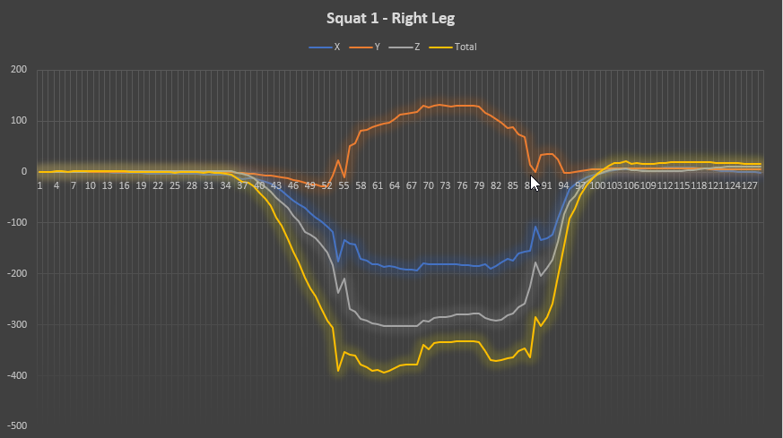
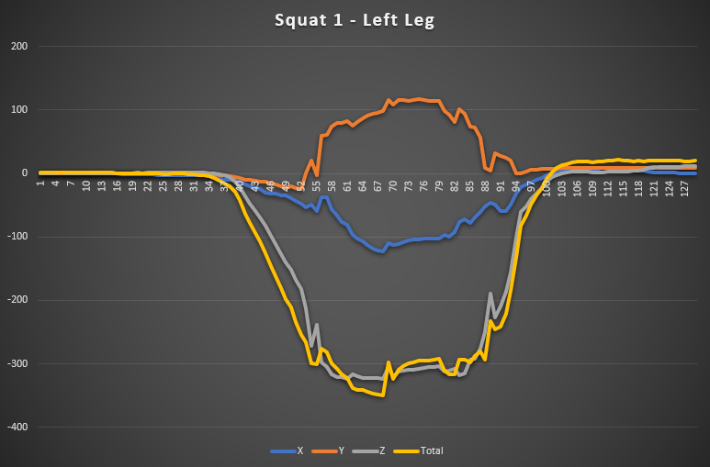
The collected data: Right and Left Leg (squat 1)
Positive
movement
Positive
movement
Negative movement
Negative movement
Notes:
Visualisation of the data using appropriate charts and/or plots

Slide 6
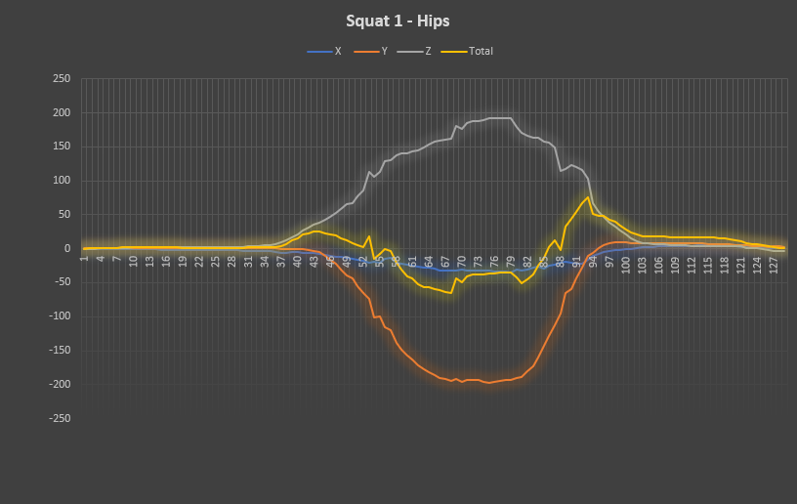
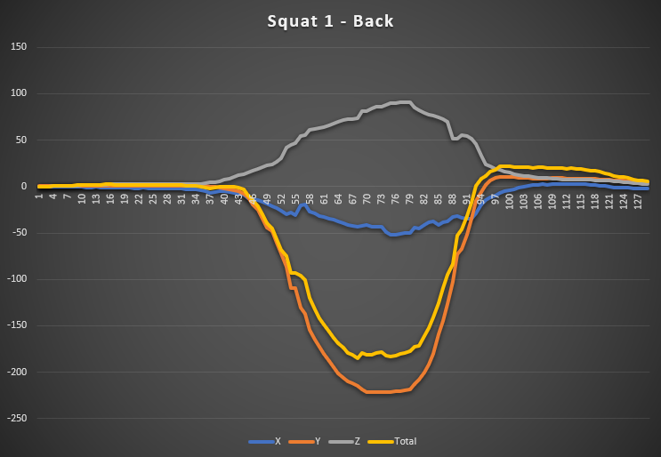
The collected data: Hips and back (squat 1)
Positive
movement
Positive
movement
Negative movement
Negative movement

Slide 7
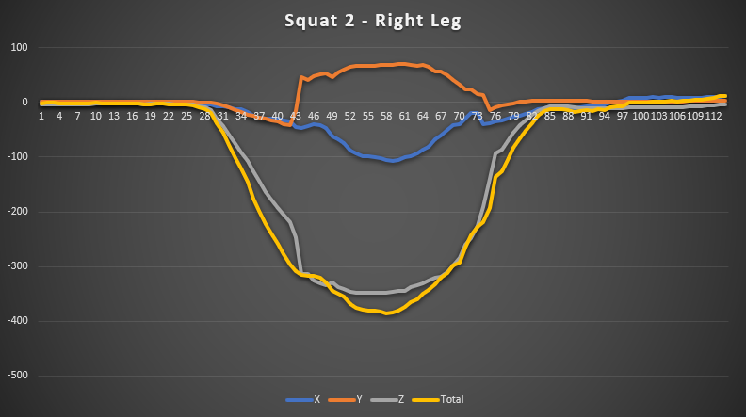
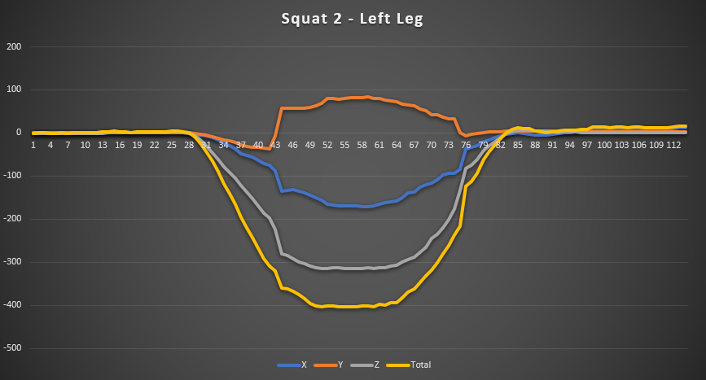
The collected data: Right and Left Leg (squat 2)
Positive
movement
Positive
movement
Negative movement
Negative movement
Notes:
Visualisation of the data using appropriate charts and/or plots

Slide 8
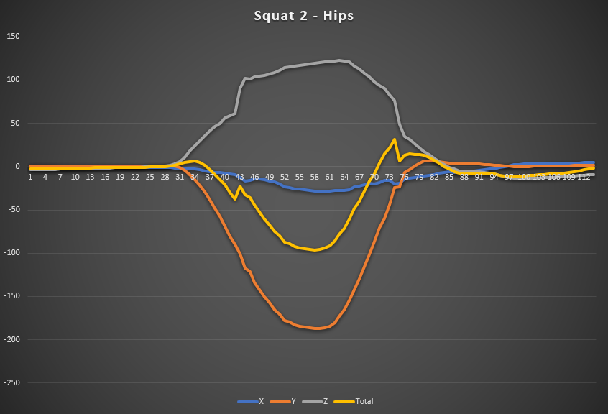
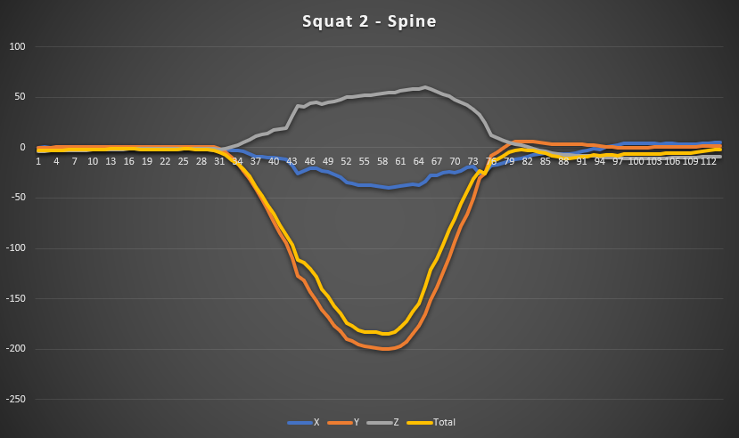
The collected data: Hips and back (squat 2)
Positive
movement
Positive
movement
Negative movement
Negative movement

Slide 9
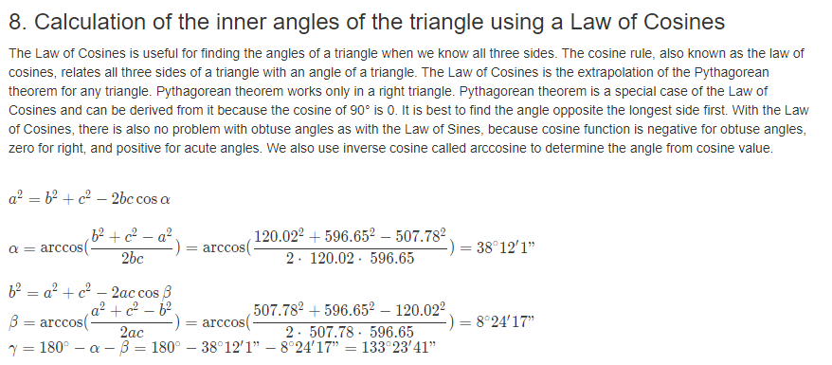
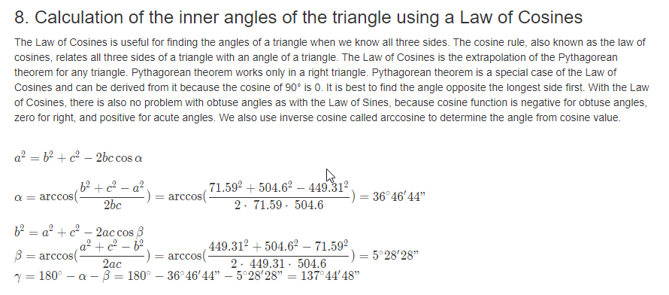
Calculating the angle for each squat
Source:
https://www.triangle-calculator.com/
First: we need to get the average XYZ positions whilst the person is squatting, this means removing still/getting into position frames (about 2 seconds worth of frames where the person is in a non-moving “Deep squat” position). Then: we must use Law of Cosines to calculate the angle of the legs in relation from the hips to the knees.
Squat #1 angle – 38.12*
Squat #2 angle – 36.46*

Slide 10
The collected data: Comparison of the squats
In order to prove that a squat is reliable: we have to compare one squat with another to ensure there are no anomalies within the data, this gives us the ability to view a margin of error to ensure that a squat isn’t too far away from a normal squat.
Notes:
Visualisation of the data using appropriate charts and/or plots

Slide 11
How this solves the client’s problem: How does this result in a better outcome?
Over long periods of time, you can see a patient’s progress easier due to computer created visual representations of the data, which allows for the client to process the information easier.
You are able to view, frame by frame the angles of someone’s squat – allowing you to put corrections into place instantly, rather than having to manually ask the person to move very slowly.
You are able to spot any issues within the recordings much easier as a visual is created. You are also able to avoid any human error as a device is plotting the coordinates instead.
Notes:
• Discussion of results obtained and how this provides a solution to the client’s problem

Slide 12
How this solves the client’s problem: How does this improve the reliability and repeatability?
Our method of measuring is more reliable as each squat’s mean angles are within an acceptable margin, which can easily be determined by viewing the data of other squats: this means that the client can be assure that the program is measuring correctly and can easily use graphs created by the program to view any anomalies within the data.
Notes:
• Discussion of results obtained and how this provides a solution to the client’s problem

Slide 13
How this solves the client’s problem: Is this method able to be done in good time?
The client’s old method would take 10+ seconds to perform and require a physio therapist to be present in order to do it. As this can now be performed by anyone (if they understand the software) it means that there’s less need for a physiotherapist to be present whilst measuring (instead they can view the squat’s data to put changes into place).
Our method takes about 3 seconds to generate data from a file and allows you to see frame by frame calculations, which couldn’t be done with the client’s old method. Thus meaning the Kinect method would be more time efficient for the patient.
Notes:
• Discussion of results obtained and how this provides a solution to the client’s problem

Slide 14
How this solves the client’s problem: Will patients see a major difference?
Instantly: it may be harder to view a difference due to the nature of the client’s request. However, overtime this method will allow physio therapists to more accurately put measures in place to help a patient based on data which previously wasn’t available due to time constraints (as you can’t measure every frame as a human).
Additionally, patients will not see a major difference in the way that data is calculated as we don’t have to put them into any special equipment (such as suits) in order to calculate the data as this can be done without changing any clothes and without any fuss.
Notes:
• Discussion of results obtained and how this provides a solution to the client’s problem

Slide 15
Question time
Please ask any questions about my solution now.

